Slide 1

Oil storage
Adam Jones
November 2016

Slide 2
Introduction
Temporary storage
Types of temporary storage
Floating
Land
Specials
  Tanker rollover
  Equipment cleaning tanks (decontamination)
Storage ratios
Benefits
Questions & answers
2

Slide 3
Temporary Storage
2

Slide 4
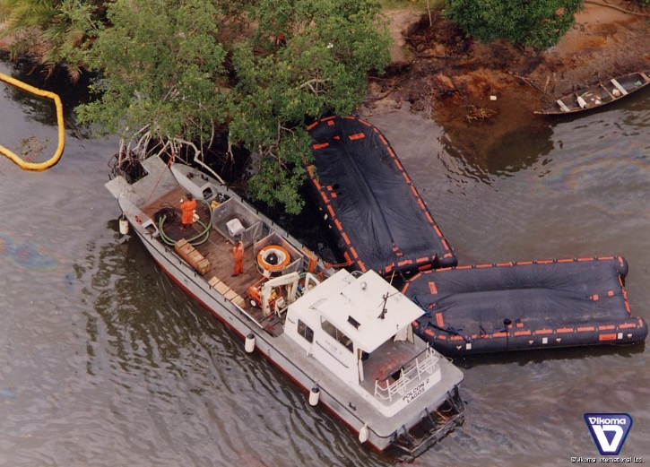
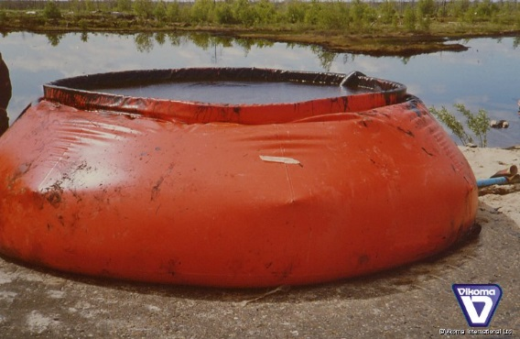
Storage types
Floating
Land
2

Slide 5
Floating storage
Floating
  Barge (FROST)
2

Slide 6
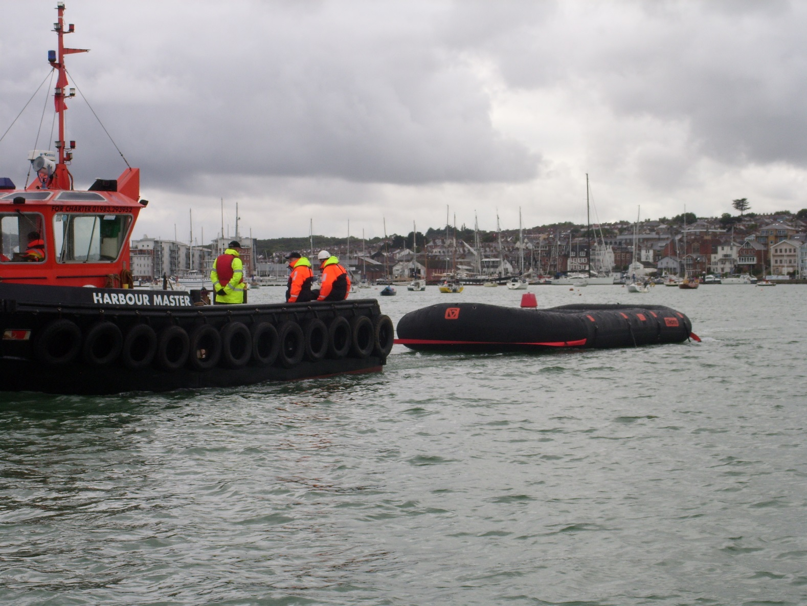
Storage barge - FROST
2

Slide 7
FROST – Sizes
Capacity
  5m3 (FR50)
  10m3
  25m3
  50m3
  100m3

Slide 8
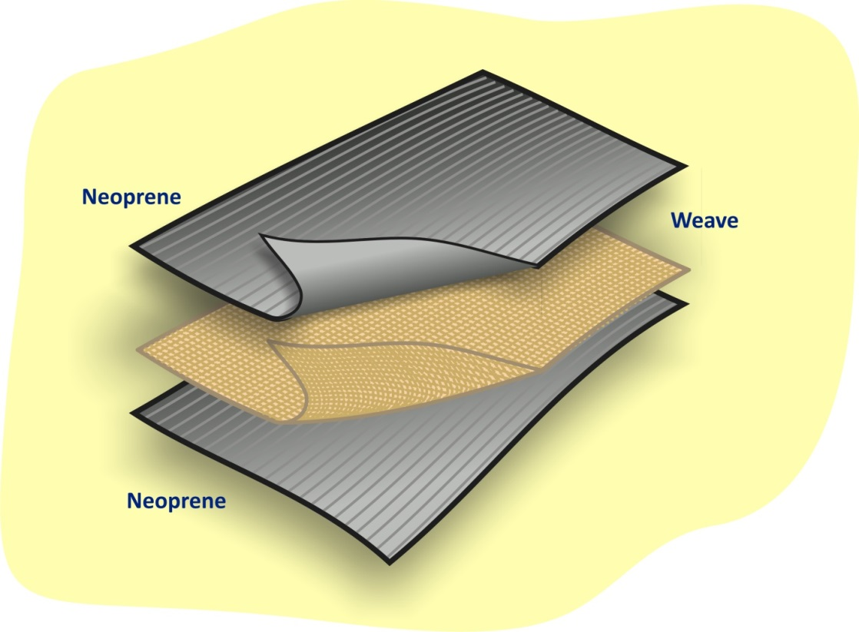
Materials
100% neoprene
Excellent resistance to hydrocarbons
Excellent resistance to salt water
High UV protection
Excellent flexibility
Excellent abrasion resistance
Vulcanised joints
Big operational range
  - 40oC to + 90oC
2

Slide 9
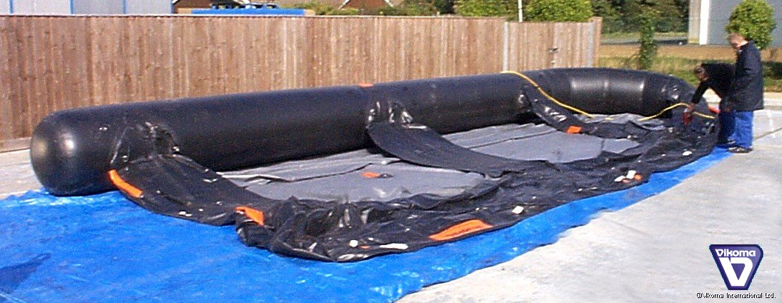
Storage barge - FROST
Segmented inflatable sections enable the tank to remain afloat if one section is punctured

Slide 10
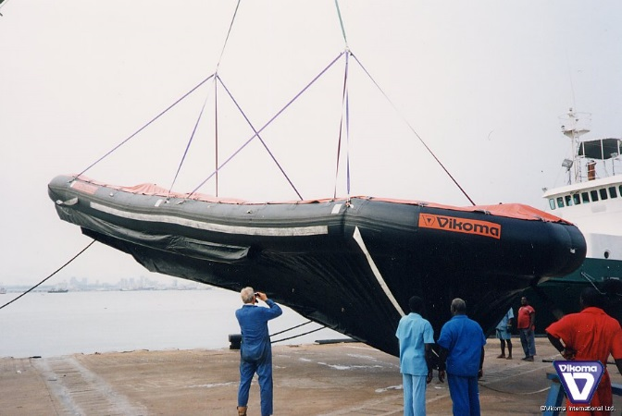
Storage barge - FROST
Certified single point lifting sling provided
Only to be lifted while emptied
Horseshoe shape bow
Boat shape gives Excellent stability
2

Slide 11
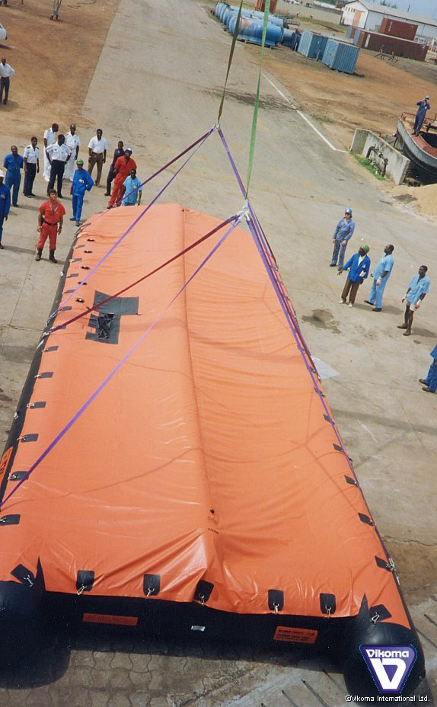
Storage barge - FROST
High visibility cover
Cover to prevent debris and water entering the tank
Skimmer discharge hose point in the top cover
Drainage point
Electric & diesel inflators available
Assisted deflation
2

Slide 12
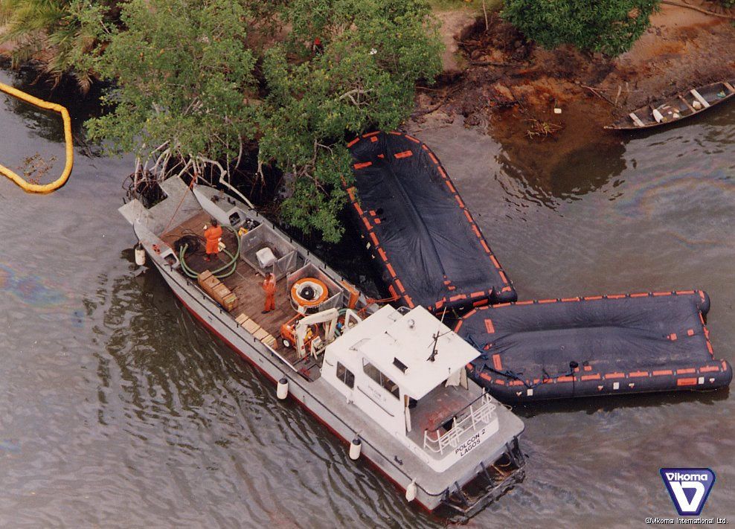
Storage barge - FROST
Easy to transport
Small storage volume
Multiple tanks can be used in a shuttle system to allow for continuous skimming operations

Slide 13
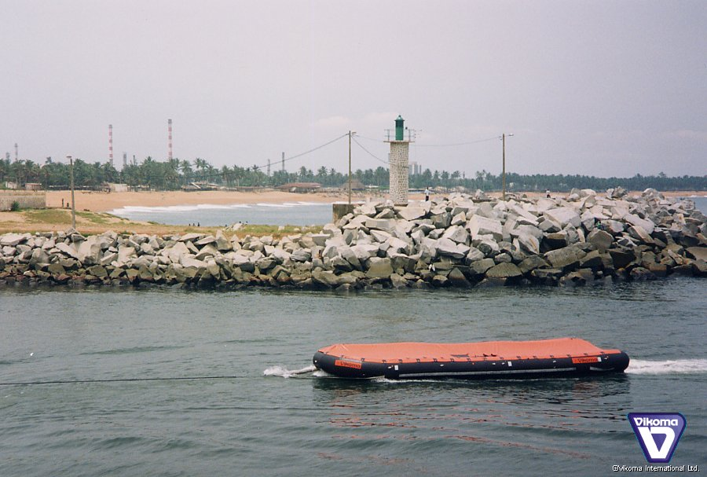
Storage barge - FROST
Towing
  4 knots full
  10 knots empty
Multiple tanks can be towed in line

Slide 14
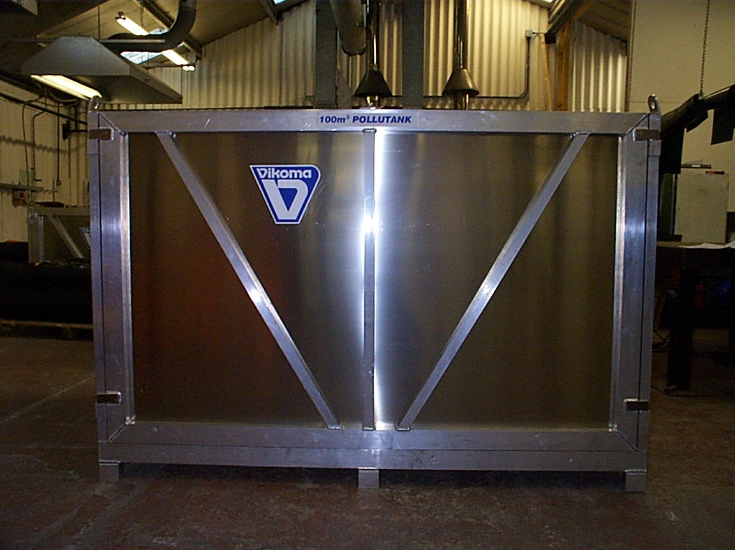
Storage barge - FROST
Aluminium storage container
All equipment housed in the container
  Tank
  Top cover
  Inflator
  Repair kit
Removable sides for easy access
Lifting points & forkliftable

Slide 15
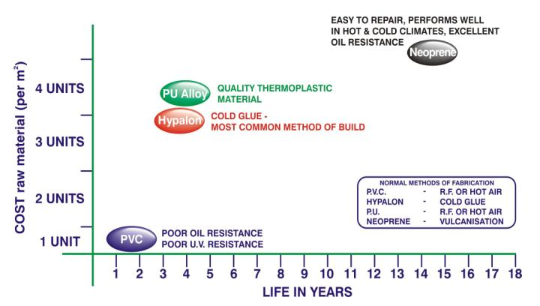
Materials
2

Slide 16
Storage ratios
Storage capacity vs skimmer recovery capacity
Customers skimmer recovery capability?
Storage capacity needs to be several times higher than skimming capacity in order to allow for continuous skimming operations.
20m3/hr skimmer could fill a 50m3 tank in 2 ½ hours
When the tank is full the skimming operation needs to stop while the tank is emptied or replaced (TIME!)
2

Slide 17
Benefits
Large range of sizes available
Small & compact when stored
Wide range of applications
Can be used in a range of climatic conditions
Easy to manoeuvre
Quick and easy to inflate/set up
2

Slide 18
Summary
Temporary storage
Types of temporary storage
Floating
Storage ratios
Benefits
Questions & answers
2

Slide 19
Questions
Q & A

Slide 20
Vikoma International Ltd
Kingston Works, Kingston Road
East Cowes
Isle of Wight
PO32 6JS. UK
T: (0)1983 200560
E: sales@vikoma.com
W: www.vikoma.com

